Slide 1

Customer Boking

Slide 2

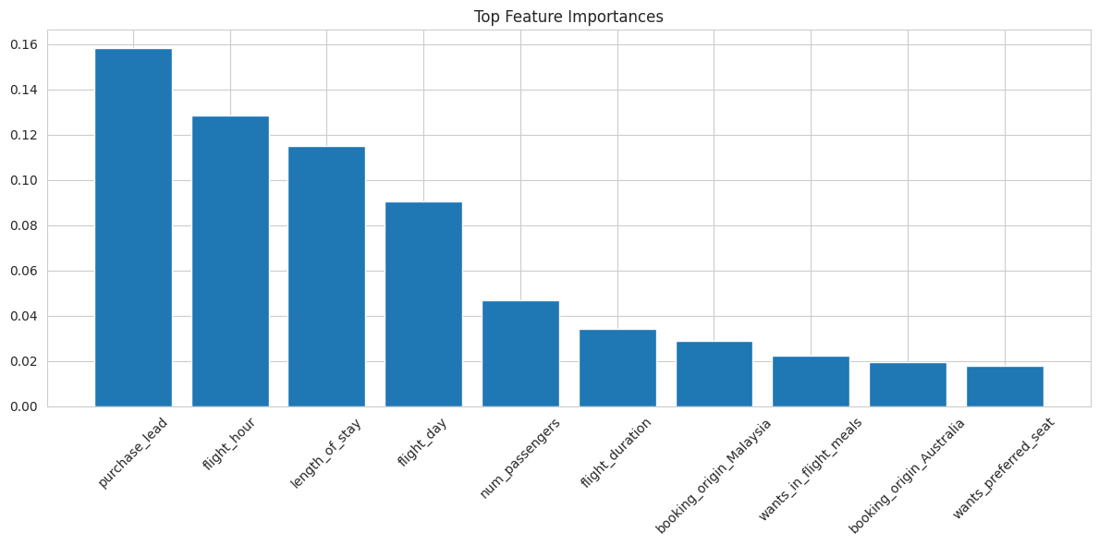
Predictive Modeling Results
Average Accuracy: 84.85%
Accuracy: 85.31%
Precision: 51%
Recall: 12%
The model demonstrates consistent performance on both cross-validation and the test set.
Despite the high accuracy, the model's recall for completed bookings is quite low. Strategies to improve recall should be explored.

